Slide 2
Serving a Changing World
Penn medicine’s strategic plan 2023-2028
Serving a Changing World—Penn Medicine’s Strategic Plan—is the roadmap that will guide our individual and collective leadership and decision-making over the next five years as we live our mission to improve the health and well-being of people in our neighborhoods, region and the world.
The design motif featured in the strategic plan was created by Nikita Rochiramani and then modified by Penn Medicine Creative Services. It draws inspiration from Maya Lin's Tree of Life sculpture that graces the Hospital of the University of Pennsylvania-Pavilion lobby. The design aims to convey that the plan will grow and evolve, to evoke the interconnectedness of our several missions, and to reflect the foundation that we will lead with humanity in everything we do.

Slide 3
Why a Strategic Plan?
01
Focus
A strategic plan helps an organization know exactly what it wants to achieve, so everyone is working towards the same important goals.
04
Communication
It improves communication because it gives everyone a clear understanding of the goals and how their work fits into the bigger picture.
02
Organization
It brings order to the organization by outlining priorities and steps to follow. This way, everyone knows what needs to be done.
05
Measurement
A strategic plan provides a way to measure progress and success, helping the organization see if it's moving in the right direction and making the desired impact.
03
Adaptation
A strategic plan helps an organization be ready for changes and challenges by thinking ahead and making plans to handle them.

Slide 4
A Bold Vision for a Bright Future
Lead with Humanity in Everything We Do
Make Breathtaking Discoveries and Put Them to Work
Simplify Care Delivery and Place It Within Reach
Develop People for Great Accomplishment
Uplift Our Community, Our Environment, and Ourselves

Slide 5
The equitable distribution of health and health care are essential elements of justice. We will treat all of our staff, all of our patients, all of our students, and all of our communities with dedication and compassion.
Goals
1
2
3
4
Reflect our Community
Give all Penn Medicine patients access to all of Penn Medicine
Model workforce humanity
Establish accountability for equity

Slide 6
Discovery propels us, improving and differentiating our service to patients, students, and the world. We will invest in opportunities we can see now and invest in an environment that creates and captures prospects not yet seen.
Goals
1
2
3
4
5
Aim our research infrastructure toward the future
Lean-in to the opportunities and imperatives of digital technology and clinical informatics
Build the infrastructure of health equity research
Release more synergies from our integrated missions
Make Penn Medicine the world’s most recognized source of scientific innovation

Slide 7
Patient Care must be easy on patients and easy on clinicians. Placing care within reach means making it accessible and affordable, offering accommodation and reassurance. We will adapt delivery systems to the needs of patients and clinicians.
Goals
1
2
3
4
Recognize science as a leading differentiator of what we bring to patients
Be, and be seen as, the most clinician-friendly health system
Make Penn Medicine a source of comfort, ease, and reassurance
Embrace anytime-anywhere

Slide 8
Health care and population health are human enterprises. We will create and deploy new approaches to transform training and professional development.
Goals
1
2
3
4
Get people into their careers faster, less expensively, and more flexibly
Create the workforce our patients and enterprise need tomorrow
Lead not just in education, but in the research and innovation of education
Advance people throughout their careers

Slide 9
We live here. We will improve our community, improve the lives of our students and staff, and improve the natural environment.
Goals
1
2
3
4
Increase life expectancy and the social and economic welfare of community residents
Establish Penn Medicine as the nation’s most environmentally-friendly health care organization
Reduce the workplace and life burdens that impede employee wellness
Advance care for our employees as we would care for our patients

Slide 10
Learning and Living the Plan
Implementation
The Strategic Plan was developed with input from various stakeholders across Penn Medicine, and its implementation will follow the same collaborative approach.
Under the direction of J Larry Jameson, EVP/Dean and Kevin Mahoney, CEO of UPHS:
Accountable Leaders are assigned to help lead the work in each Strategic Goal.
A steering committee oversees implementation and progress.

Slide 11
Learning and Living the Plan
Implementation & resources
For Managers:
Take time to read the Strategic Plan document thoroughly to understand its goals, strategies, and overall direction.
The Plan is meant to provide an inspiring vision of the goals for the institution and how we can help our communities. People already choose to work at Penn Medicine because of those desires to serve a greater good, and the Plan is a reminder of that.
Think about how the goals apply to your everyday work and guide your team to do the same. Which plan elements are most relevant will be different for each group.
Keep the plan at the forefront of your work. Include it as a topic at your regular staff meetings.
Avoid the trap of thinking you have your work and now you also have to advance the Strategic Plan. Align your individual and team goals with the Strategic Plan. This is our new roadmap.

Slide 12
Exercise
How can my work contribute to the goals of penn medicine’s strategic plan?
The strategic plan was built with feedback and guidance from across our organization. Now, all of us will play a critical role to realize our vision for a healthier world.
The best way to contribute to the success of the plan is to keep doing what you’ve always done! As a unique and valuable part of the Penn Medicine community, your continued hard work and expertise in your role will move us closer to achieving the goals in our plan.
We want you to feel connected to and inspired by our shared objectives and know that your contributions matter.
We invite you to write down your thoughts about how you can help Penn Medicine achieve some of the Strategic Plan goals across the five pillars.
Then, share and discuss your thoughts with your manager and colleagues during your team meetings.

Slide 13
Exercise
How can my work contribute to the goals of penn medicine’s strategic plan?
Lead with Humanity in Everything We Do
Make Breathtaking Discoveries and Put Them to Work
Simplify Care Delivery and Place It Within Reach
Develop People for Great Accomplishment
Uplift Our Community, Our Environment, and Ourselves
Add notes here
Add notes here
Add notes here
Add notes here
Add notes here

Slide 14
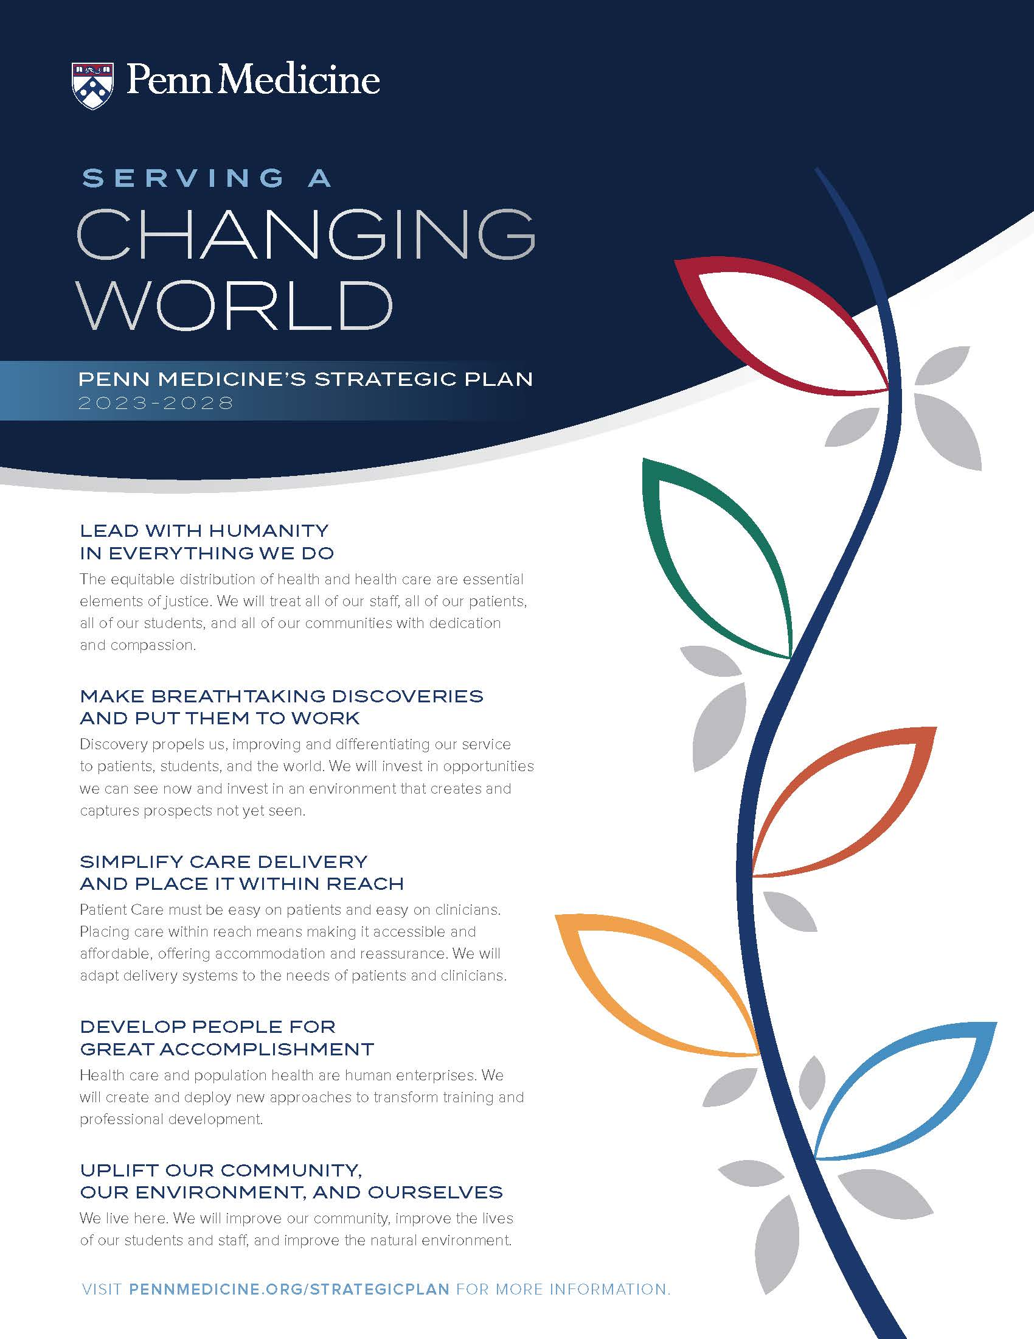
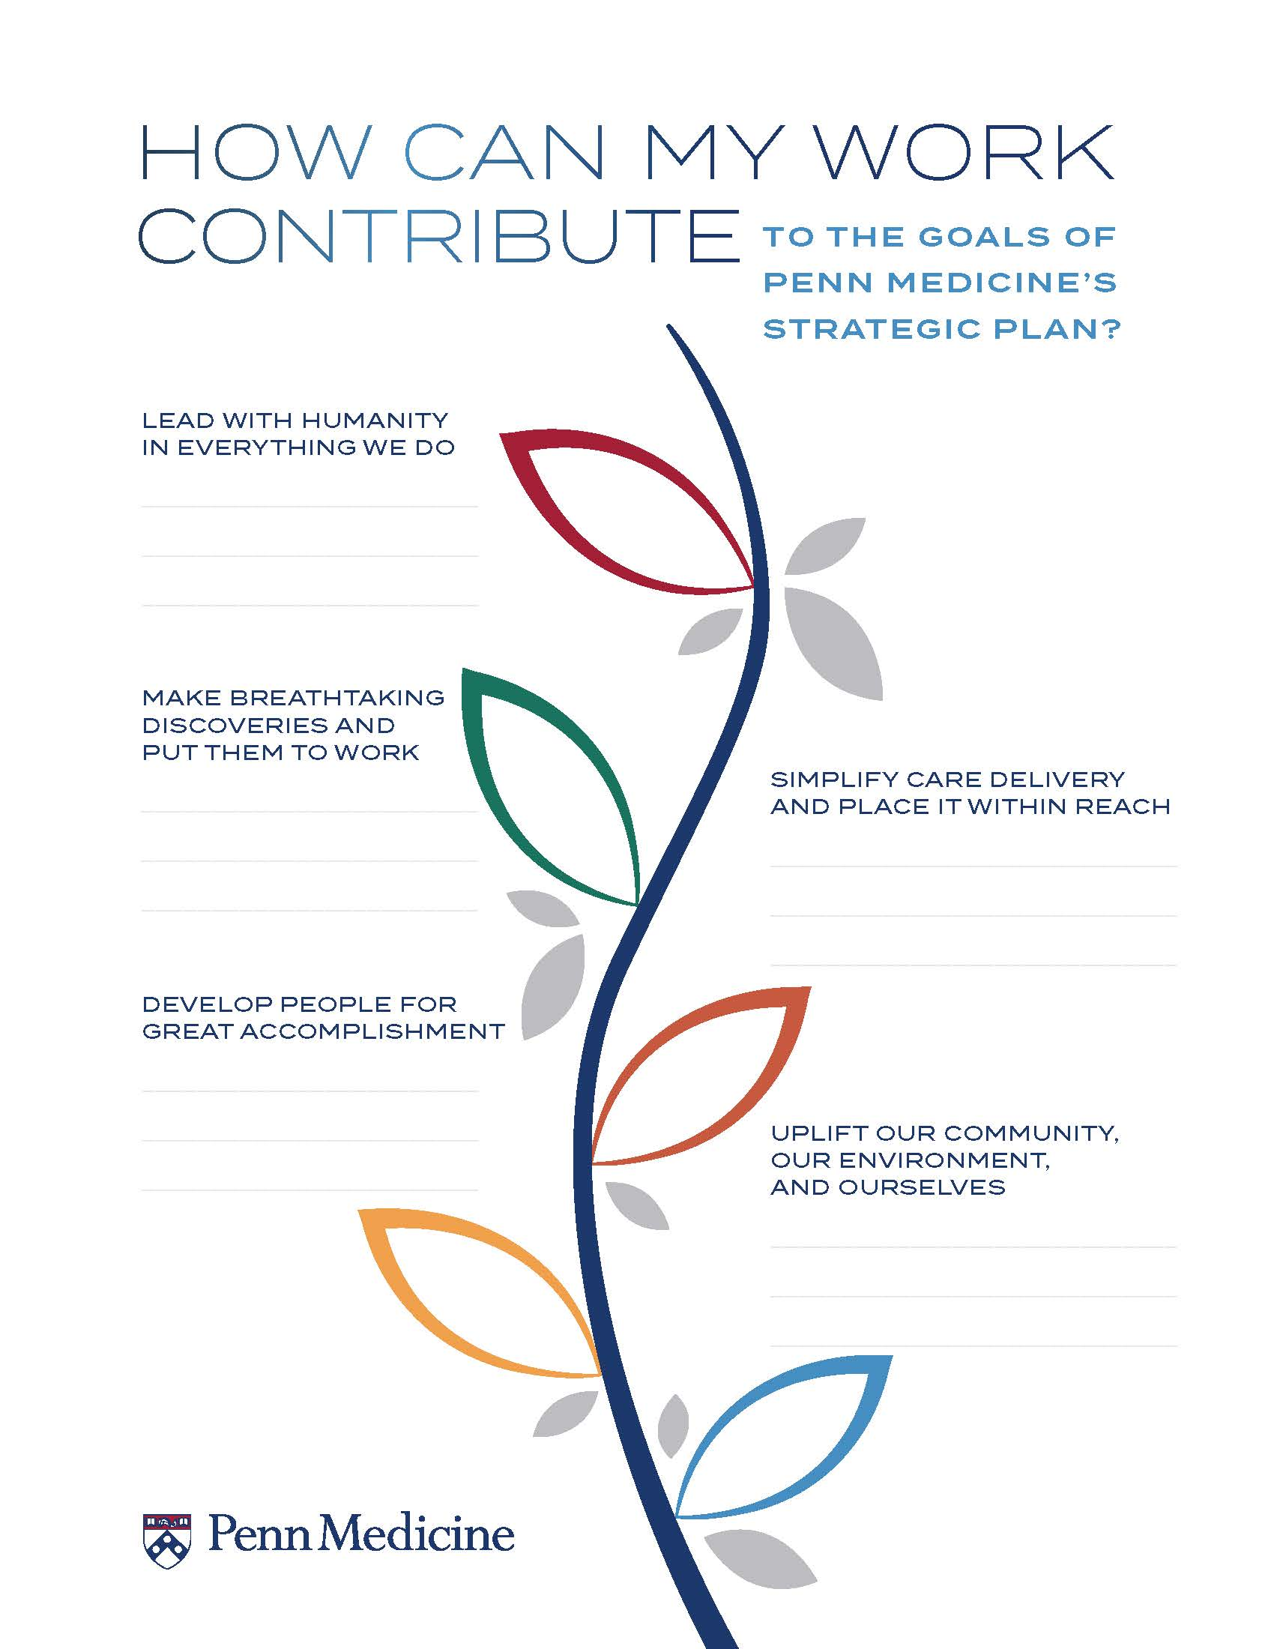
Want to Learn More?
Explore these resources to acquaint yourself with the Strategic Plan and discover ways to contribute.
Penn Medicine’s 2023-2028 Strategic plan resources
Strategic Plan Website
PennMedicine.org/strategic-plan-2023-2028
Share questions, thoughts & ideas about the Strategic Plan
strategicplanning@pennmedicine.upenn.edu
Access Strategic Plan slides in Templafy

